Slide 1
Ocean Colour Thematic Assembly Center - MED
Gianluca Volpe
Italian National Research Council
Regional User Training Workshop
La Spezia, December 4th, 2015

Slide 2
Outline
Background info on OCTAC system
Background info on Ocean Colour
OCTAC product info
Use of Reflectances
Use of Chl measurements
Navigating the Catalogue

Slide 3
OCTAC MyOcean heritage
The OCTAC is a distributed system which acts as a Production Centre of high-quality OC products
It provides operational service to Copernicus Marine Environment Monitoring Service (CMEMS) - the legacy of GMES
The OCTAC Ocean regions are: GLO (global ocean), EUR (Pan-European Seas), ARC (Arctic Ocean), BAL (Baltic Sea), ATL (Atlantic Ocean), BS (Black Sea), and MED (Mediterranean Sea).

Slide 4
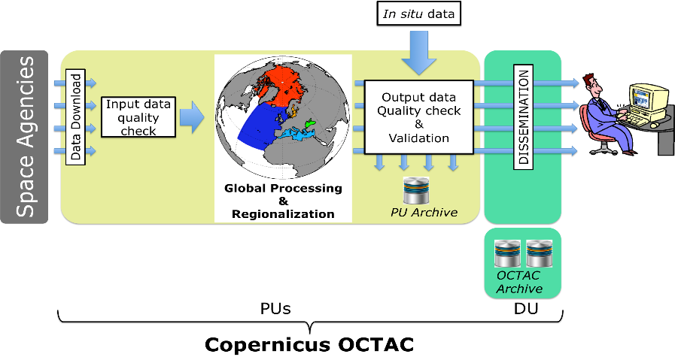
CMEMS OC TAC: Architecture evolution

Slide 5
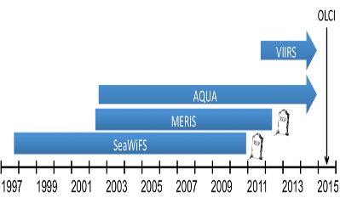
CMEMS OC TAC: Architecture evolution

Slide 6
CMEMS OC TAC: Architecture evolution
Regional ad hoc algorithms operationally implemented

Slide 7
OCTAC Products
TWO main product categories
Ocean Optics
Ocean Chlorophyll
Products may include several datasets (Sat. sensors)
Ocean Optics
R_{rs} (λ)
K_{d}
Ocean Chlorophyll
Case I (no longer available in V2)
Merged Case I - Case II
Products (names or codes) may differ with respect to
the Timing of Release (NRT/DT or REP)

Slide 8
Timing of Product release
NRT with preliminary or no ancillary data
(same or next day)
DT with final ancillary data
(after 5 days)
Currently under investigation and sensible to change from April 2016
REP when improved Cal/Val affords improved products
(once a year)

Slide 9
OCTAC Products
TWO main product categories
Ocean Optics
Ocean Chlorophyll
Products may include several datasets (Sat. sensors)
Ocean Optics
R_{rs} (λ)
K_{d}
Ocean Chlorophyll
Case I (no longer available in V2)
Merged Case I - Case II
Products (names or codes) may differ with respect to
the Timing of Release (NRT/DT or REP)
Processing Level (L3 or L4)

Slide 10
Processing Levels
L2: this is the input data from space agency
L3: geophysical product (1 km)
daily resolution
all swaths over the spatial domain combined together
L4: geophysical product
averaged over weekly and monthly time scale (1 km)
interpolated (data voids due to clouds filled by statistical methods) (4 km)
1 km, from April 2016 (CMEMS V2)

Slide 11
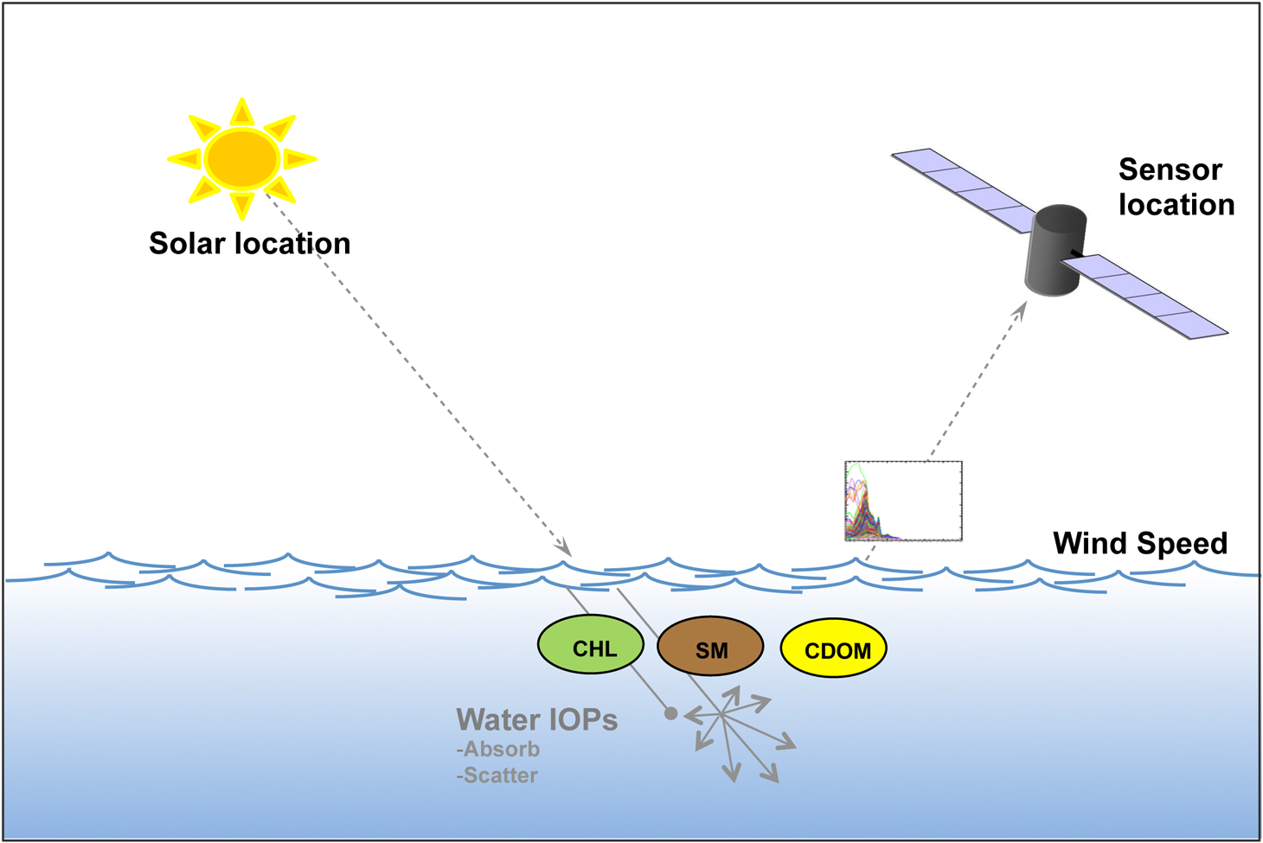
OC Basic Info
LIGHT emitted from the sun INTERACTS with the SEAWATER and its CONSTITUENTS before being captured by the remote sensor
Ocean Colour is the description of the optical properties of the medium through which the light propagates

Slide 12
OC Basic Info
LIGHT emitted from the sun INTERACTS with the SEAWATER and its CONSTITUENTS before being captured by the remote sensor
The bulk, or large-scale, optical properties of water are conveniently divided into two mutually exclusive classes: INHERENT and APPARENT.

Slide 13
OC Basic Info
Light emitted from the sun INTERACTS with the SEAWATER and its CONSTITUENTS before being captured by the remote sensor
The bulk, or large-scale, optical properties of water are conveniently divided into two mutually exclusive classes: INHERENT and APPARENT
INHERENT OPTICAL PROPERTIES (IOPs) are those properties that depend only upon the medium, and therefore are independent of the ambient light field within the medium

Slide 14
OC Basic Info
Light emitted from the sun INTERACTS with the SEAWATER and its CONSTITUENTS before being captured by the remote sensor
The bulk, or large-scale, optical properties of water are conveniently divided into two mutually exclusive classes: INHERENT and APPARENT
APPARENT OPTICAL PROPERTIES (AOPs) are those properties that depend both on the medium (the IOPs) and on the geometric (directional) structure of the ambient light field, and that display enough regular features and stability to be useful descriptors of the water body

Slide 15
OC Basic Info
The spectral downwelling Irradiance (E_{d}) is the total amount of light reaching a surface area element, from all the upward directions
E_{d}(λ,z)

Slide 16
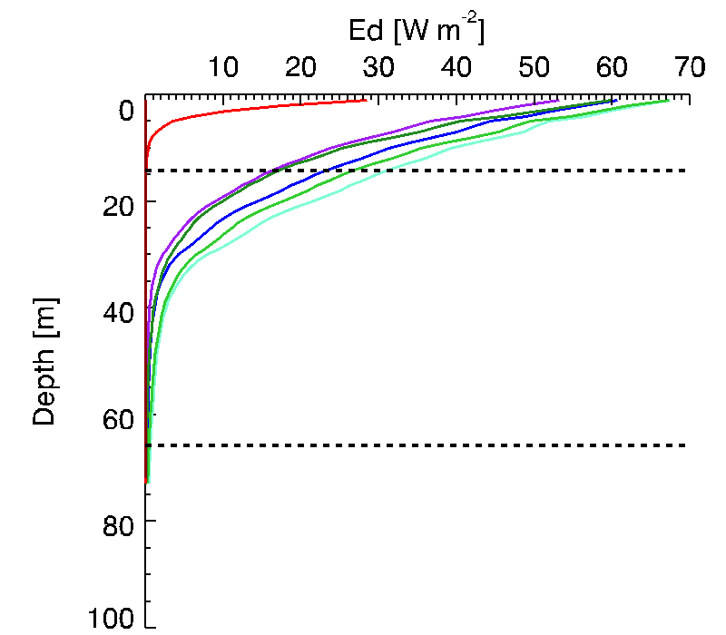
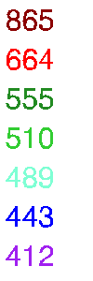
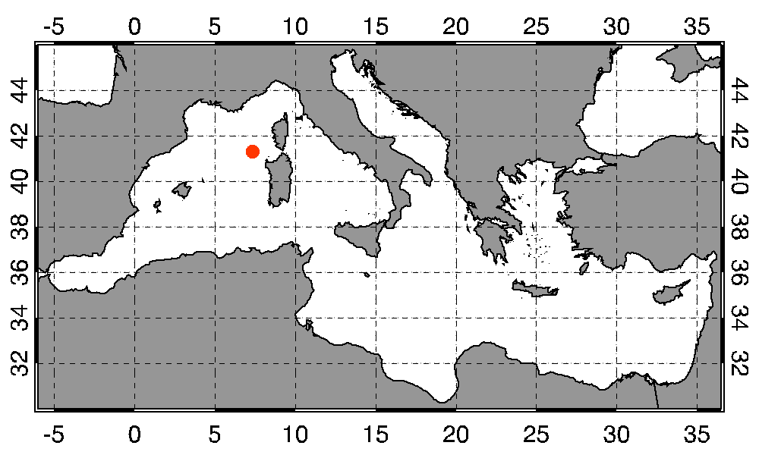
OC Basic Info
The spectral downwelling Irradiance (E_{d}) is the total amount of light reaching a surface area element, from all the upward directions
E_{d}(z) ≈ E_{d}(0⁻)e^{-Kdz}
E_{d}(λ,z)
April 12th, 2014

Slide 17
OC Basic Info
is the vertical attenuation coefficient for downward irradiance and describes the rate of change of E_{d}(λ) with depth
E_{d}(z) ≈ E_{d}(0⁻)e^{-Kdz}
K_{d}

Slide 18
OC Basic Info
is the vertical attenuation coefficient for downward irradiance and describes the rate of change of E_{d}(λ) with depth
has units of m⁻¹
smaller K_{d} values
E_{d}(z) ≈ E_{d}(0⁻)e^{-Kdz}
less attenuation
K_{d}
greater water Transparency

Slide 19
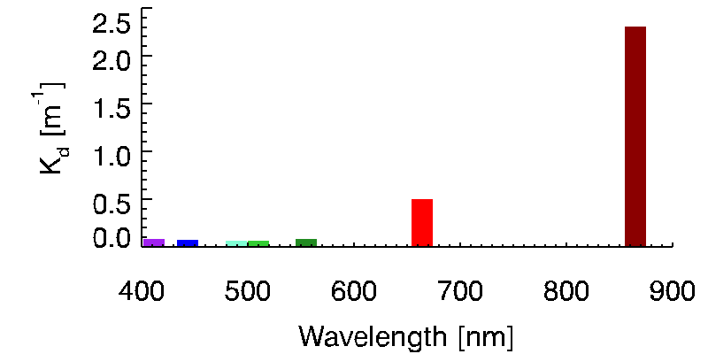
OC Basic Info
E_{d}(z) ≈ E_{d}(0⁻)e^{-Kdz}
K_{d} = 0.01 m⁻¹
E_{d}(1m) = 99% E_{d}(0⁻)
K_{d} = 0.1 m⁻¹
E_{d}(1m) = 90% E_{d}(0⁻)
K_{d} = 1 m⁻¹
E_{d}(1m) = 36% E_{d}(0⁻)

Slide 20
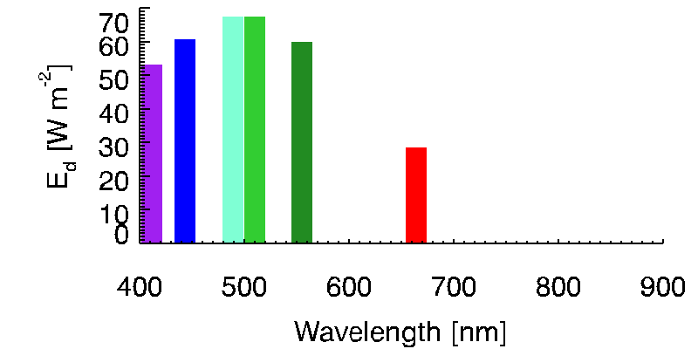
OC Basic Info
Z_{eu}
Z_{pd} ~
4.6
E_{d}(z) ≈ E_{d}(0⁻)e^{-Kdz}
Z_{eu} ~ 1% PAR (0⁺)
E_{d}(λ,z)
April 12th, 2014

Slide 21
OC Basic Info
The spectral upwelling Radiance (L_{u}) is the amount of light reaching a surface area element, through one solid angle
L_{u}(λ,z)

Slide 22
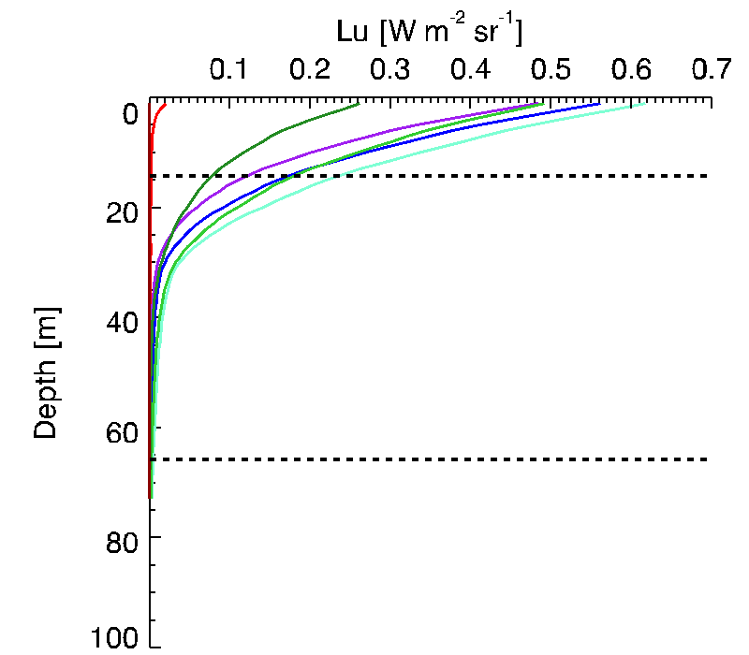
OC Basic Info
The spectral upwelling Radiance (L_{u}) is the amount of light reaching a surface area element, through one solid angle
Z_{pd}
L_{u}(λ,z)
Z_{eu}
April 12th, 2014

Slide 23
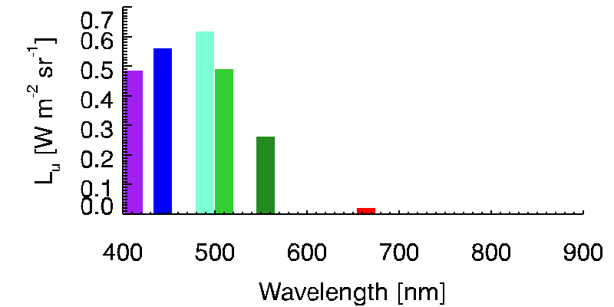
OC Basic Info
Z_{pd}
L_{u}(λ,z)
Z_{eu}
April 12th, 2014

Slide 24
OC Basic Info
L_{u}
R_{rs}(λ,0⁺) ~
E_{d}

Slide 25
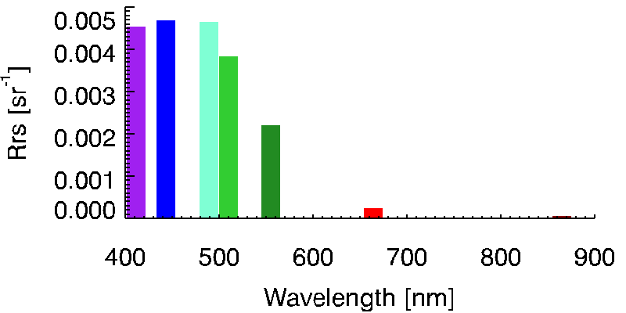
OC Basic Info
L_{u}
R_{rs}(λ,0⁺) ~
E_{d}

Slide 26
OC Basic Info
L_{u}
R_{rs}(λ,0⁺) ~
E_{d}
The quantity of interest to us

Slide 27
OC Basic Info
L_{u}
R_{rs}(λ,0⁺) ~
E_{d}
MAX(R_{rsBlue})
< 550 nm
MBR =
R_{rsGreen}
~ 550 nm
Maximum Band Ratio

Slide 28
OC Basic Info
Case I waters
Open ocean
Optical signal variability is WELL explained by the variability in phytoplankton biomass
(i.e., Chlorophyll)
Case II waters
Coastal waters
Optical signal variability is ONLY PARTIALLY explained by the variability in phytoplankton biomass
CDOM & TSM can play a significant role

Slide 29
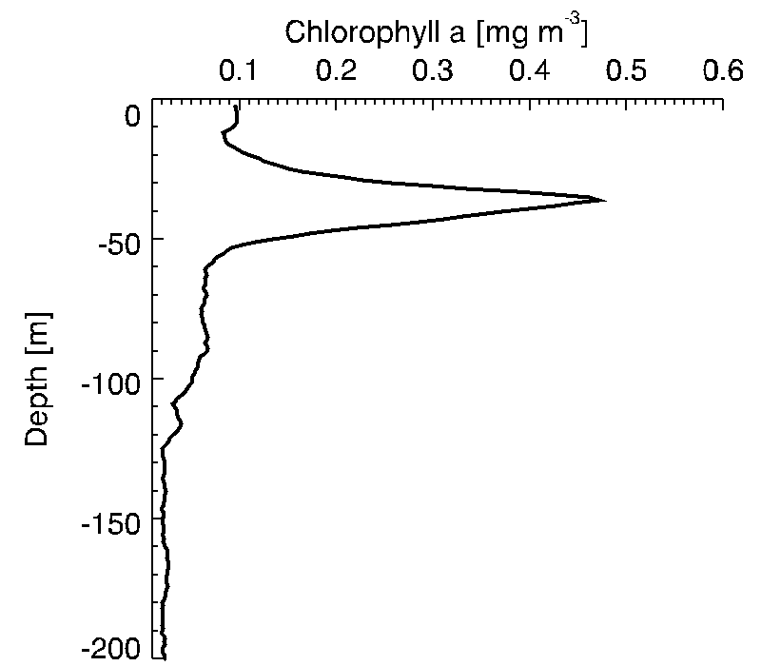
Chlorophyll
April 12th, 2014

Slide 30
Chlorophyll
Z_{eu}
April 12th, 2014

Slide 31
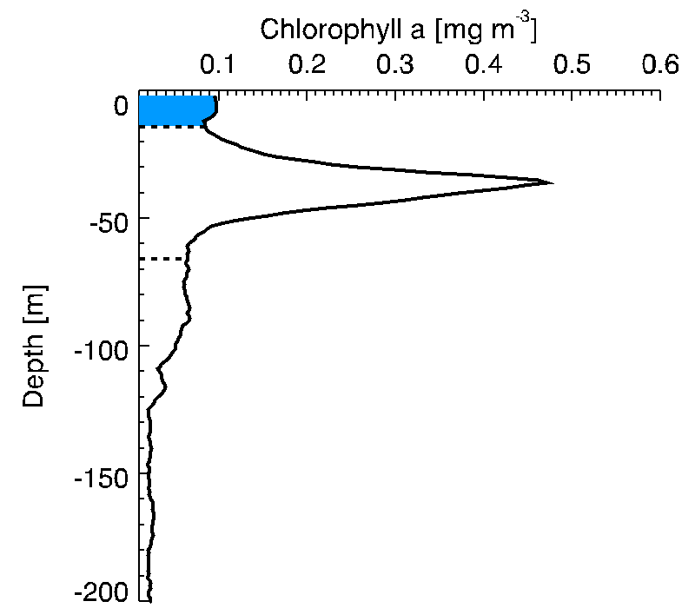
Chlorophyll
Z_{pd}
Z_{eu}
April 12th, 2014

Slide 32
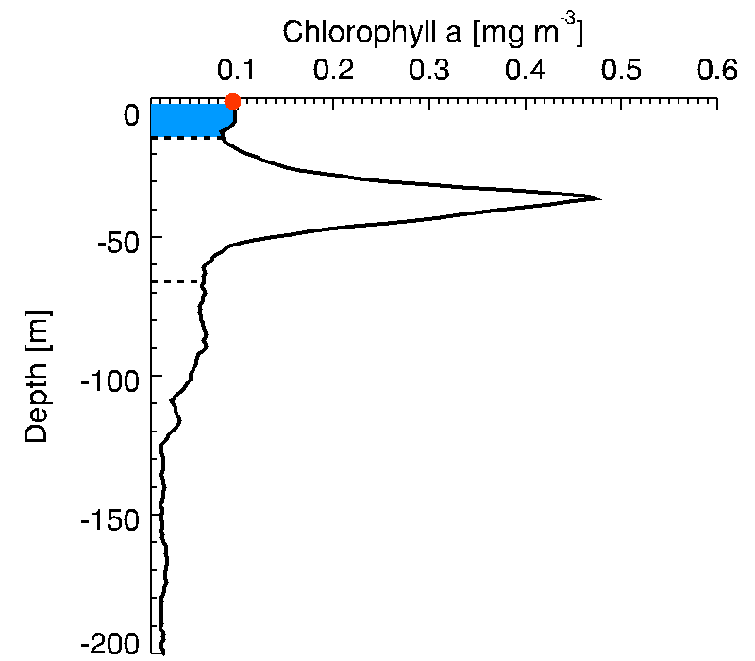
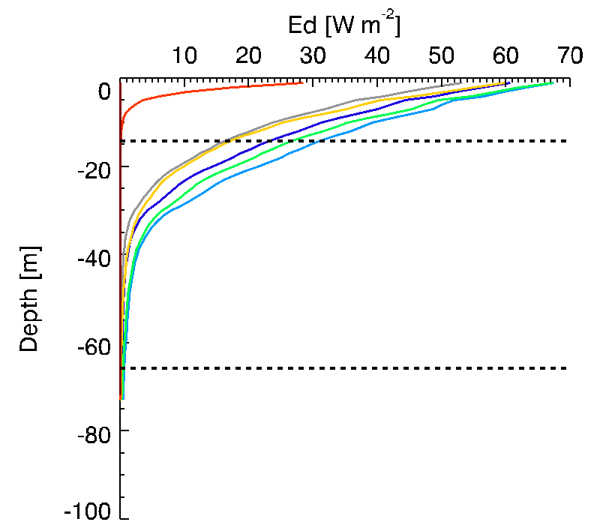
Chlorophyll
Z_{pd}
Z_{eu}
April 12th, 2014

Slide 33
Chlorophyll
Z_{pd}
Important: OC gives you information about the surface ocean!
Z_{eu}
April 12th, 2014

Slide 34
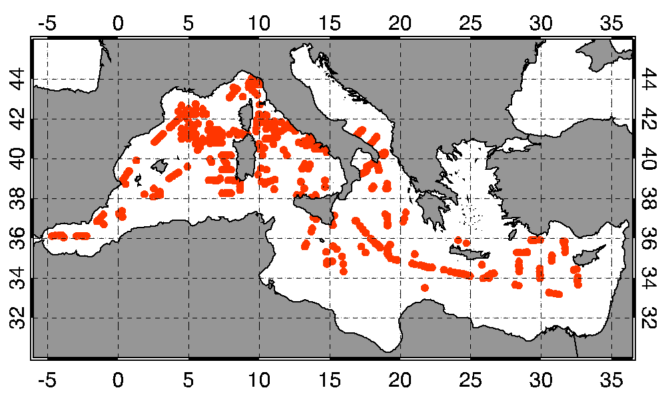
MedOC in situ dataset
Bio-optical measurements
> 800 Chl/Opt measurements to define the Mediterranean regional algorithms for Case I waters

Slide 35
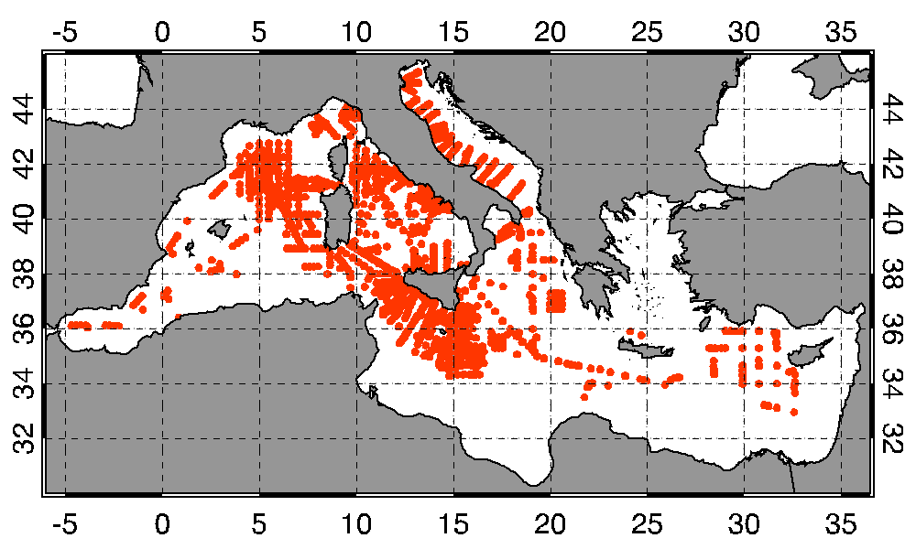
MedOC in situ dataset
Bio-optical measurements
> 800 Chl/Opt measurements to define the Mediterranean regional algorithms for Case I waters
Chl Profiles
> 2600 chlorophyll profiles for satellite data VALIDATION

Slide 36
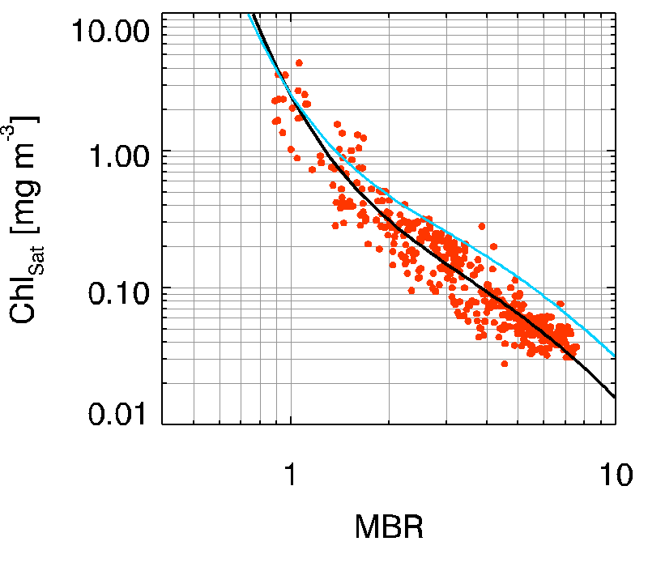
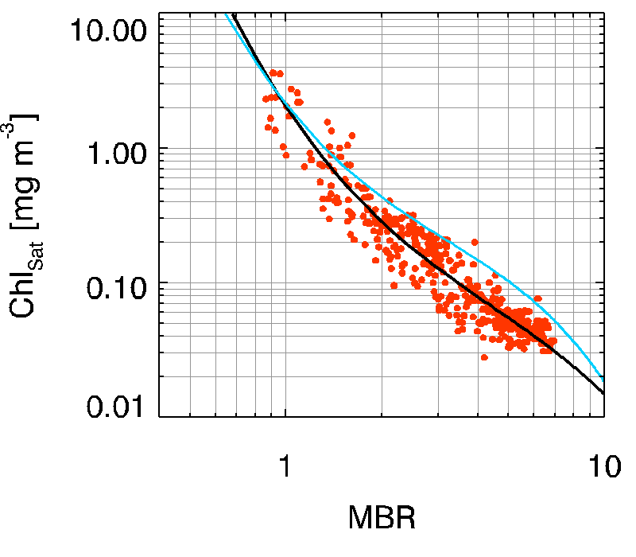
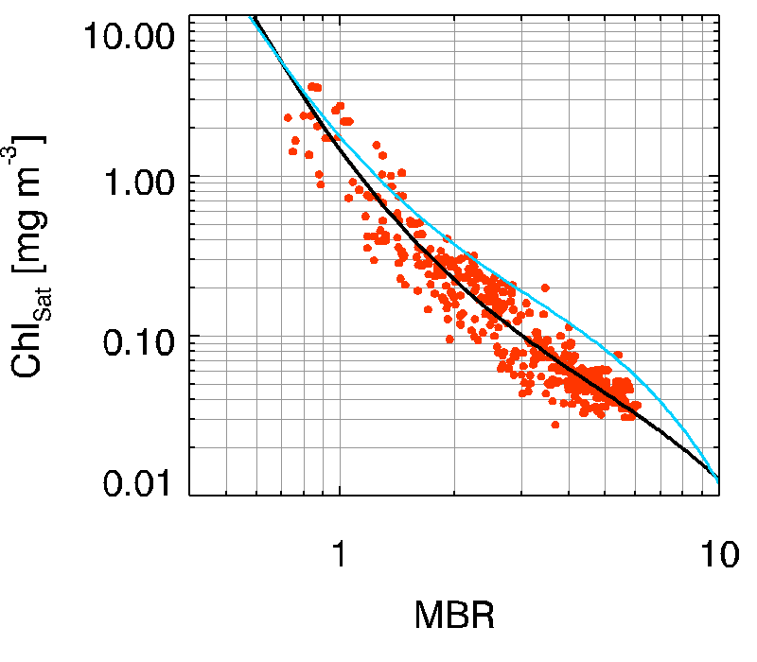
UNIQUE in situ dataset to develop sensor-specific algorithms for Case I waters
MERIS
SeaWiFS
VIIRS
MODIS

Slide 37
UNIQUE in situ dataset to develop sensor-specific algorithms for Case I waters
MERIS
SeaWiFS
Chl < 0.5 mg m⁻³
Global algorithms systematically overestimate in situ measurements
Statistically, 0.5 mg m⁻³ comprises more than 75% of the data values (not only in situ)
VIIRS
MODIS

Slide 38
UNIQUE in situ dataset to develop sensor-specific algorithms for Case I waters
MERIS
SeaWiFS
Chl > 0.5 mg m⁻³
Global and Regional overlap
VIIRS
MODIS

Slide 39
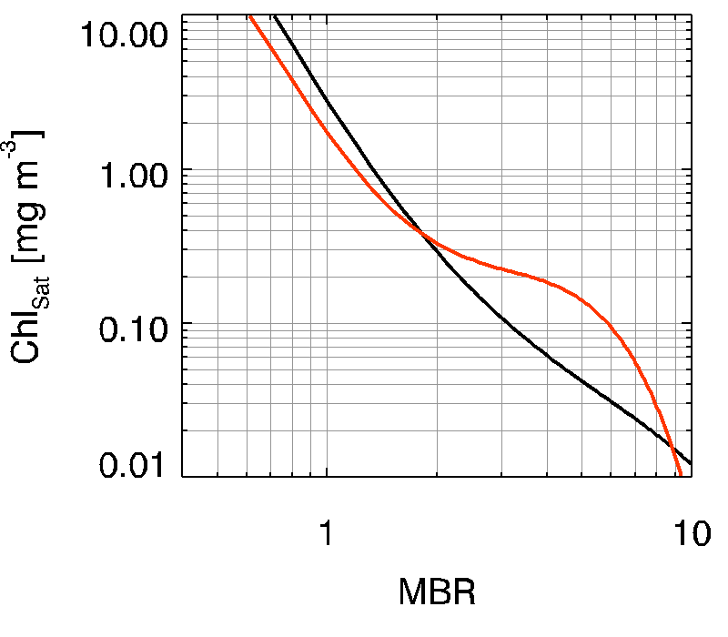
Case II water Algorithm
MBR = 1.9
Case II water Algorithm: AD4
D’Alimonte & Zibordi [2003]
Chl_{Case II} < Chl_{Case I}
Chl = 0.4 mg m⁻³
Chl_{Case II} > Chl_{Case I}
Case II
Case I

Slide 40
Case I - Case II Chl MERGING
On a pixel-by-pixel basis, the satellite Rrs spectrum is compared with the distributions of the two in situ datasets: Case I and Case II
The Mahalanobis distance parameter is used for quantifying the distance of the i^{th} satellite pixel spectrum, x, from the reference in situ datasets, µ
Chl_{CaseI}Δ²_{CaseI} + Chl_{CaseII}Δ²_{CaseII}
Chl_{Merged}
=
Δ²_{CaseI} + Δ²_{CaseII}

Slide 41
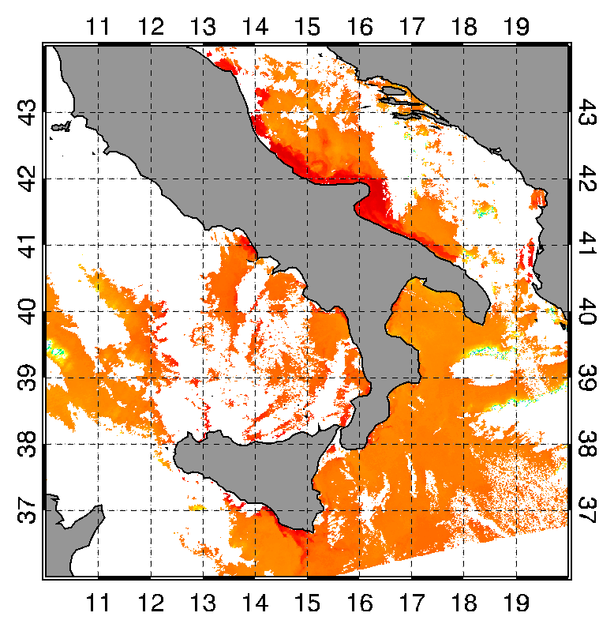
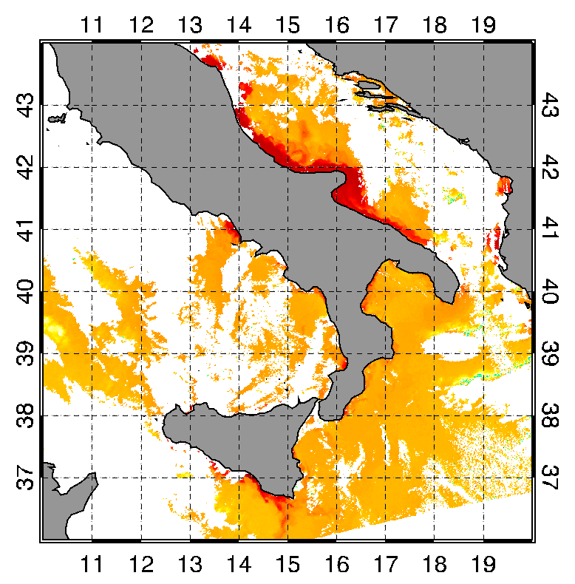
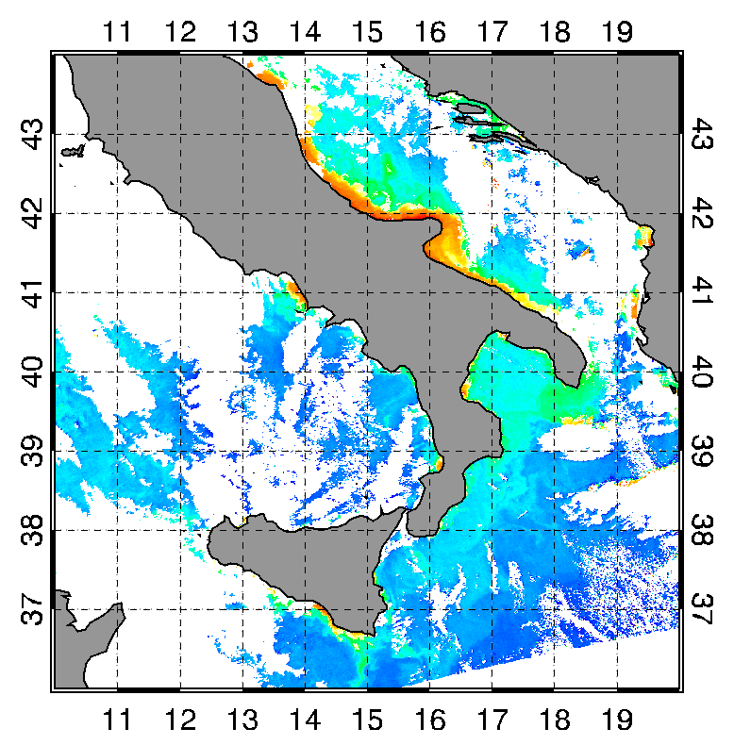
Case I water Algorithm
MBR
Rrs443
Rrs488
Rrs547
Blue
Green
Chl Case I

Slide 42
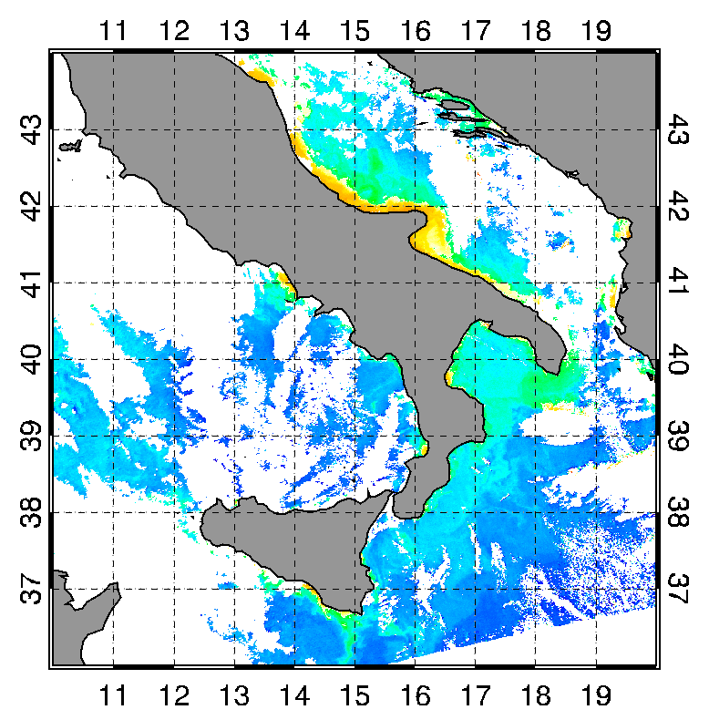
Merging Case I – Case II
MBR
Rrs443
Rrs488
Rrs547
Blue
Green
MERGED Chl

Slide 43
Merging Case I – Case II
Chl Case I

Slide 44
Merging Case I – Case II
Merged Chl

Slide 45
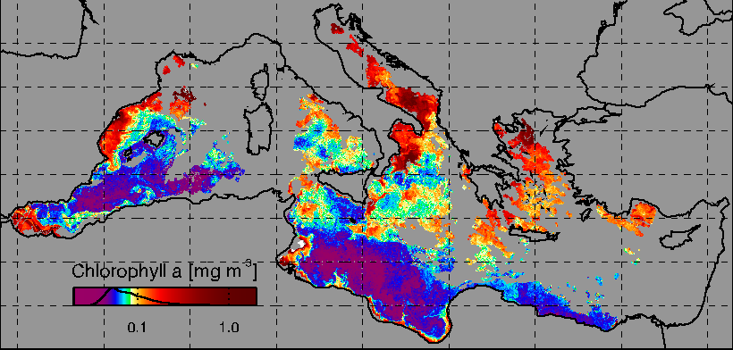
Level 3 & Level 4 Products
To fill in initial gaps and to initialize the EOF procedure, Daily Observations and Daily Climatology are combined via Smoothing Procedure method
Level 3

Slide 46
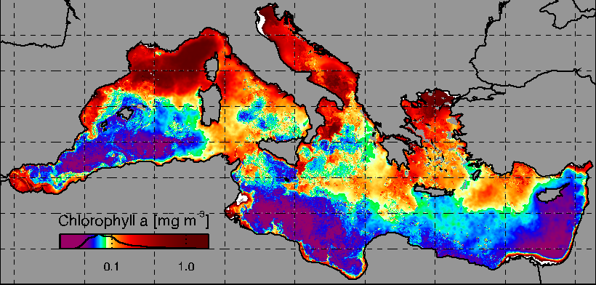
Level 3 & Level 4 Products
To fill in initial gaps and to initialize the EOF procedure, Daily Observations and Daily Climatology are combined via Smoothing Procedure method
Input

Slide 47
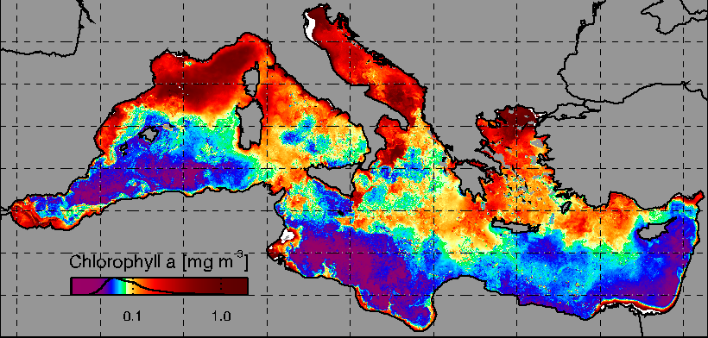
Level 3 & Level 4 Products
To fill in initial gaps and to initialize the EOF procedure, Daily Observations and Daily Climatology are combined via Smoothing Procedure method
Level 4

Slide 48
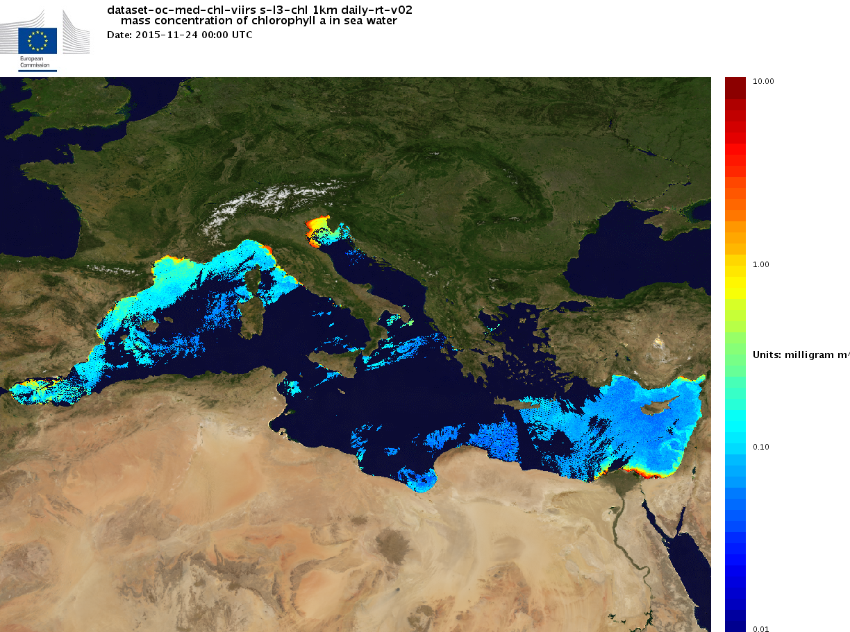

Slide 49
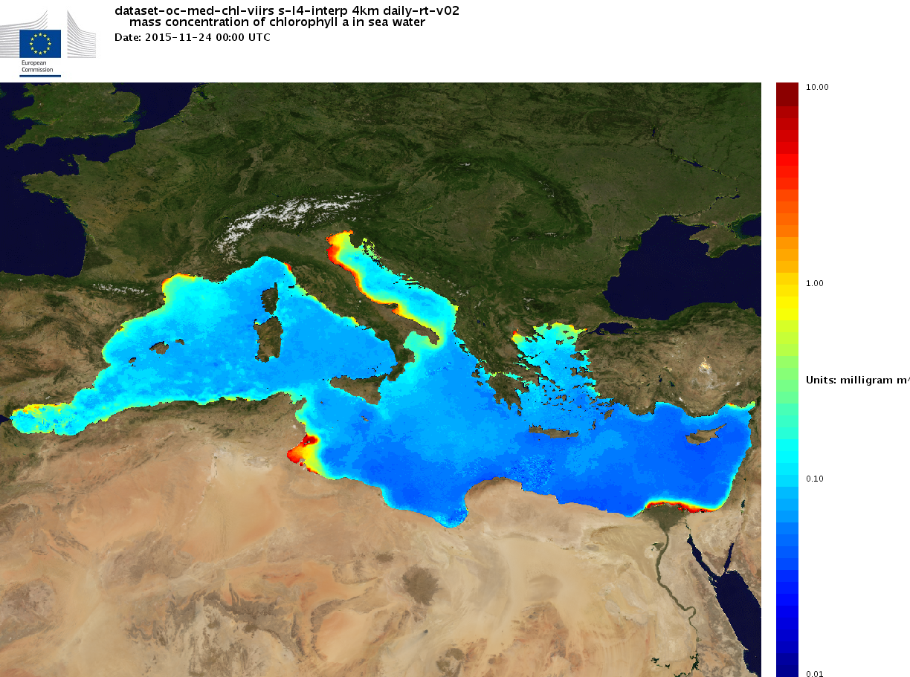

Slide 50
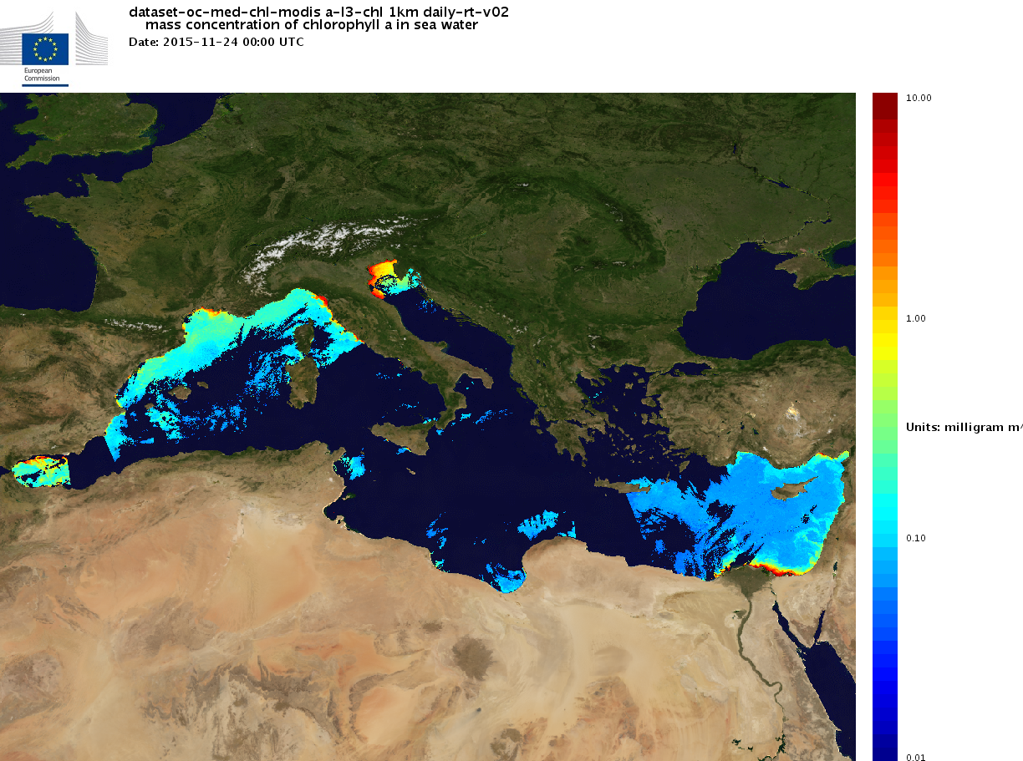

Slide 51
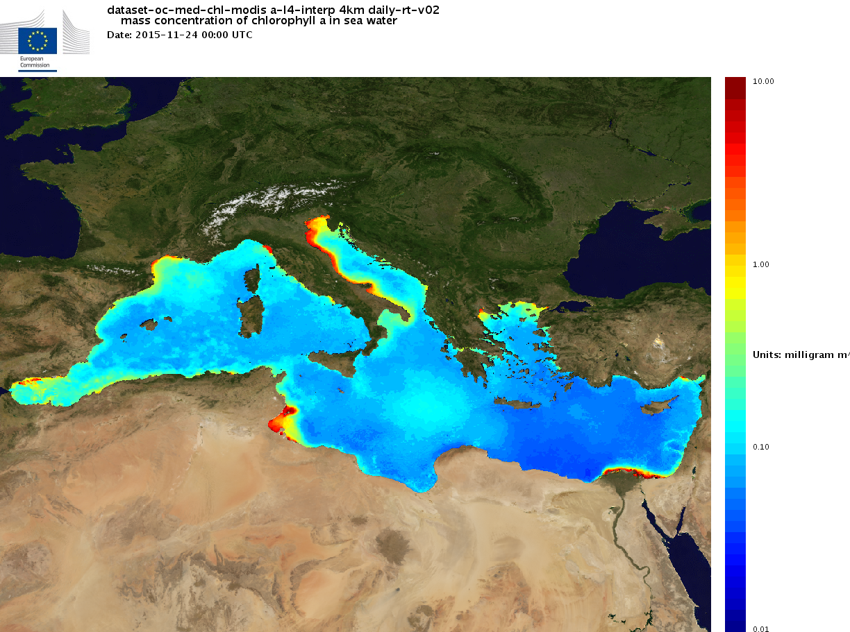

Slide 52
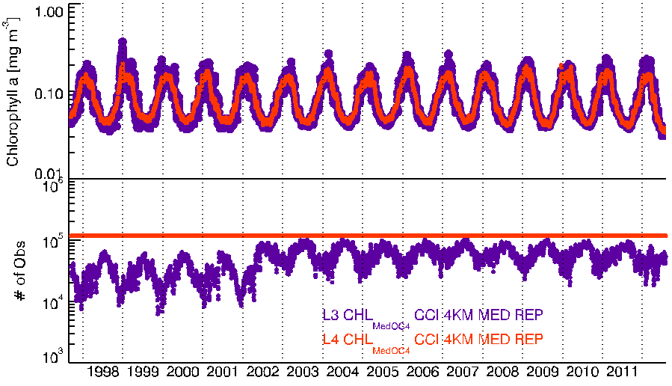
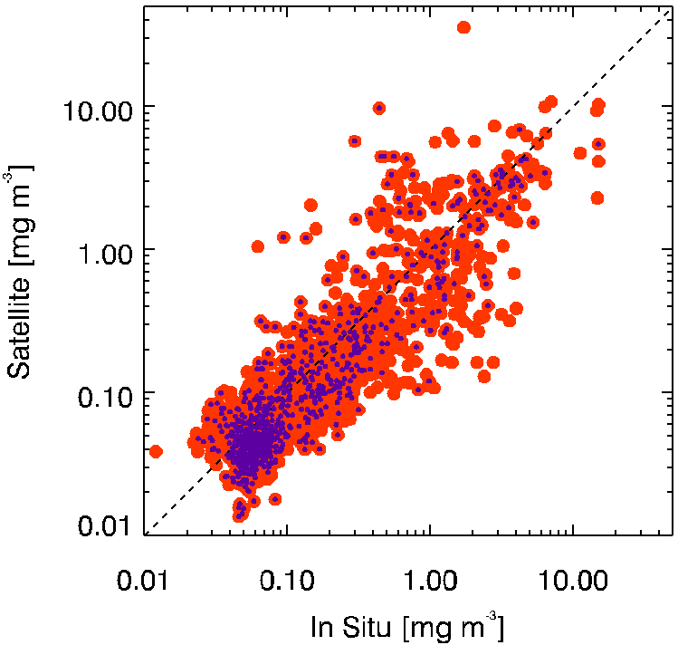
REP products derived
from ESA-CCI
New version available (April, 2016) with data up to 2014

Slide 53
Quality Index
CurrentDataPixel - ClimatologyDataPixel
QI =
STDDataPixel

Slide 54
Quality Index
CurrentDataPixel - ClimatologyDataPixel
QI =
STDDataPixel

Slide 55
Quality Index
CurrentDataPixel - ClimatologyDataPixel
QI =
STDDataPixel

Slide 56
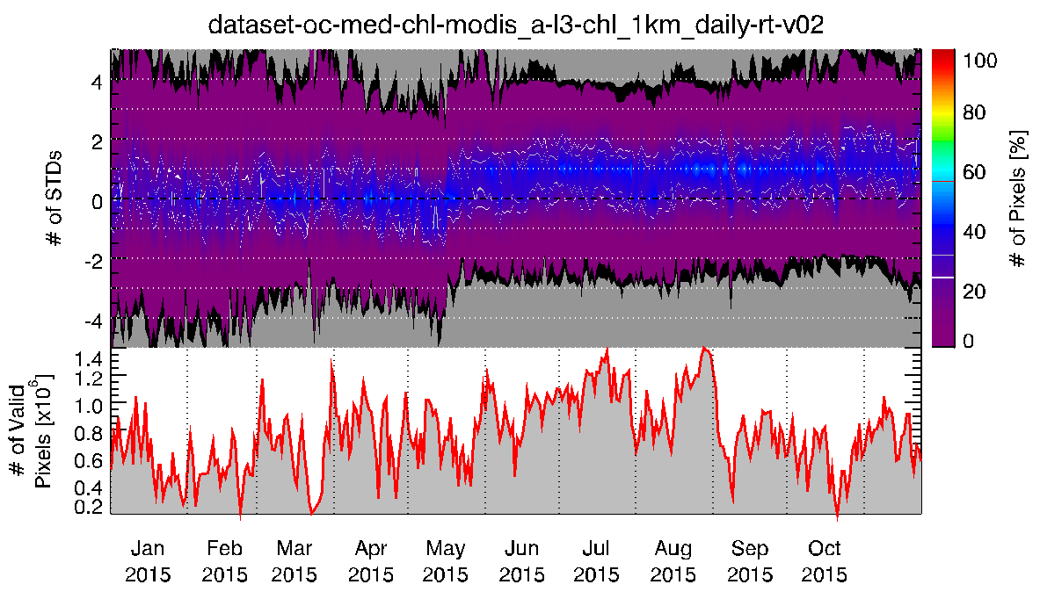
Quality Index

Slide 57
http://marine.copernicus.eu

Slide 58
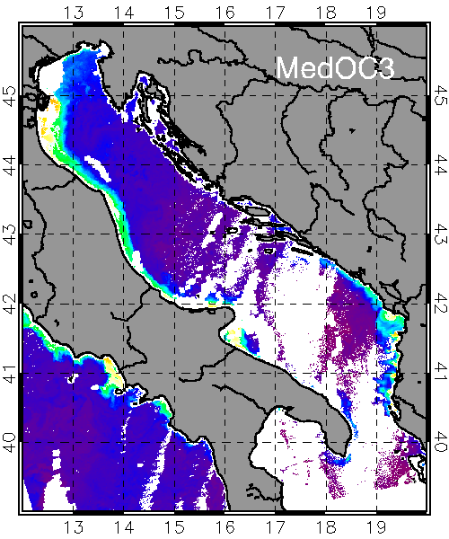
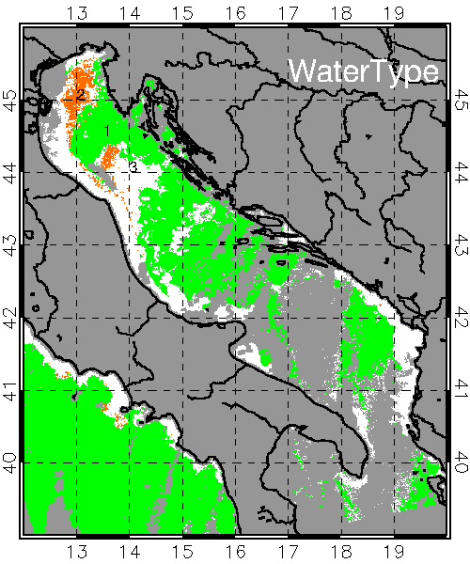
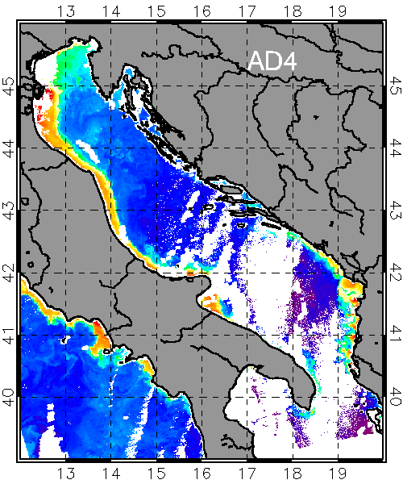
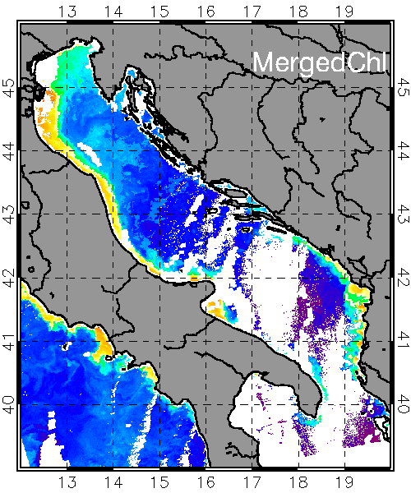
Case I & Case II Chl data merging
10.0
3.2
1.0
0.32
0.10
0.03
Case I
2
Case II
1
NOVEL
3

Slide 59
Panoply MAP config
Center Lon: 15.25
Center Lat: 38
Width: 42.5
Height:16

Slide 60
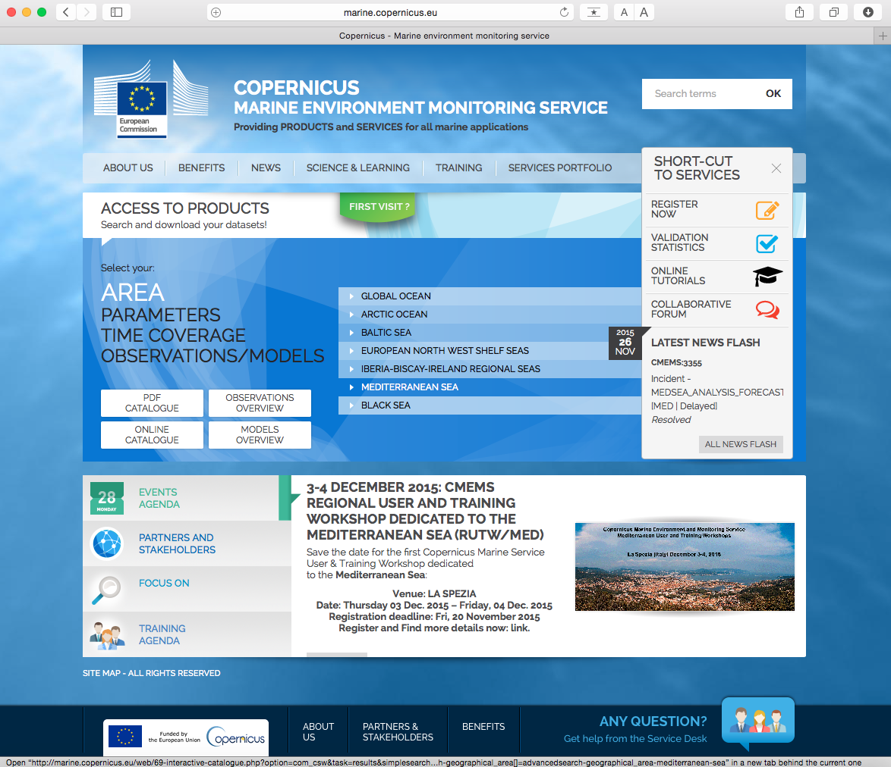
Navigating Med Sea Products in CMEMS Online Catalog

Slide 61
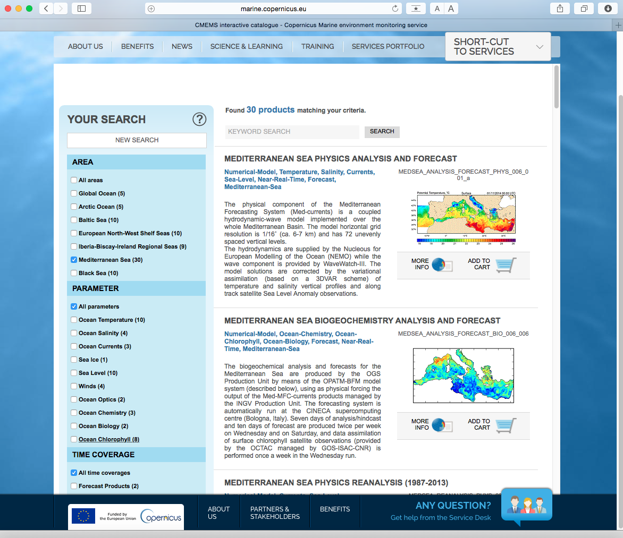
Navigating Med Sea Products in CMEMS Online Catalog

Slide 62
Navigating Med Sea Products in CMEMS Online Catalog

Slide 63
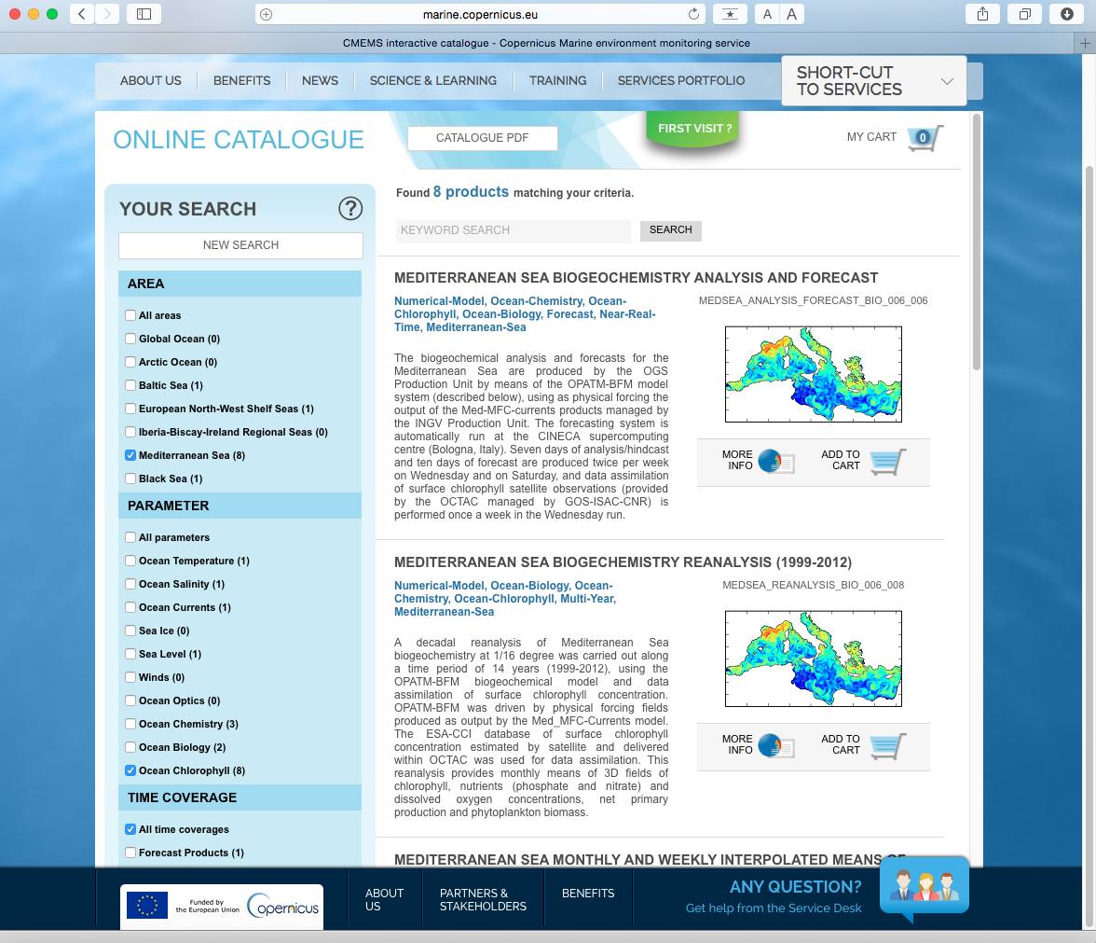
Navigating Med Sea Products in CMEMS Online Catalog

Slide 64
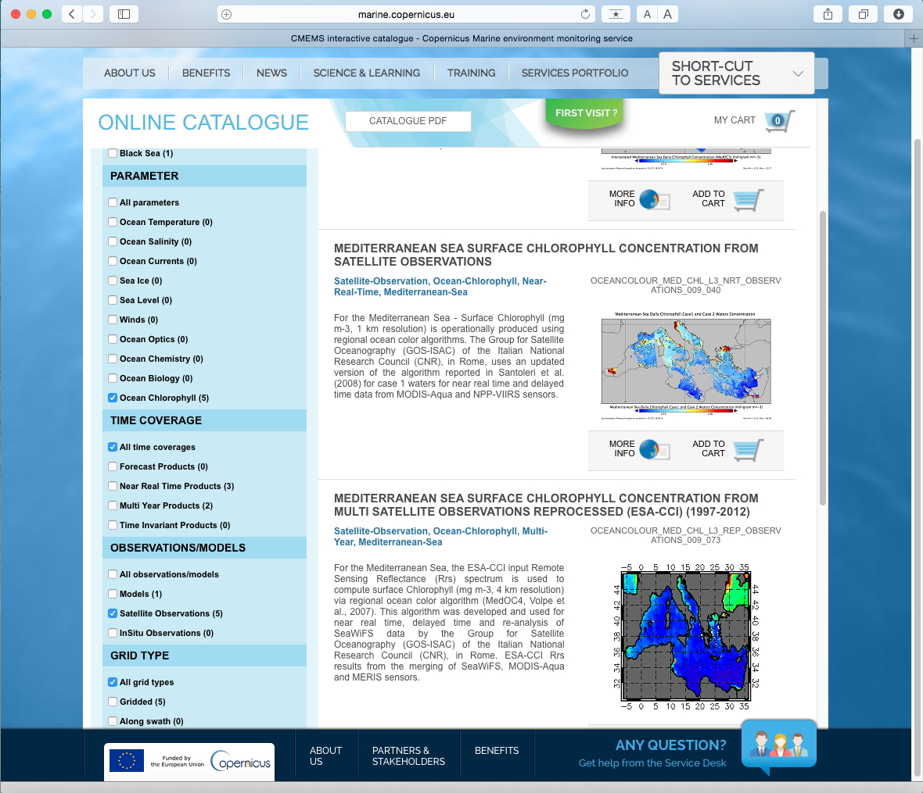
Navigating Med Sea Products in CMEMS Online Catalog

Slide 65
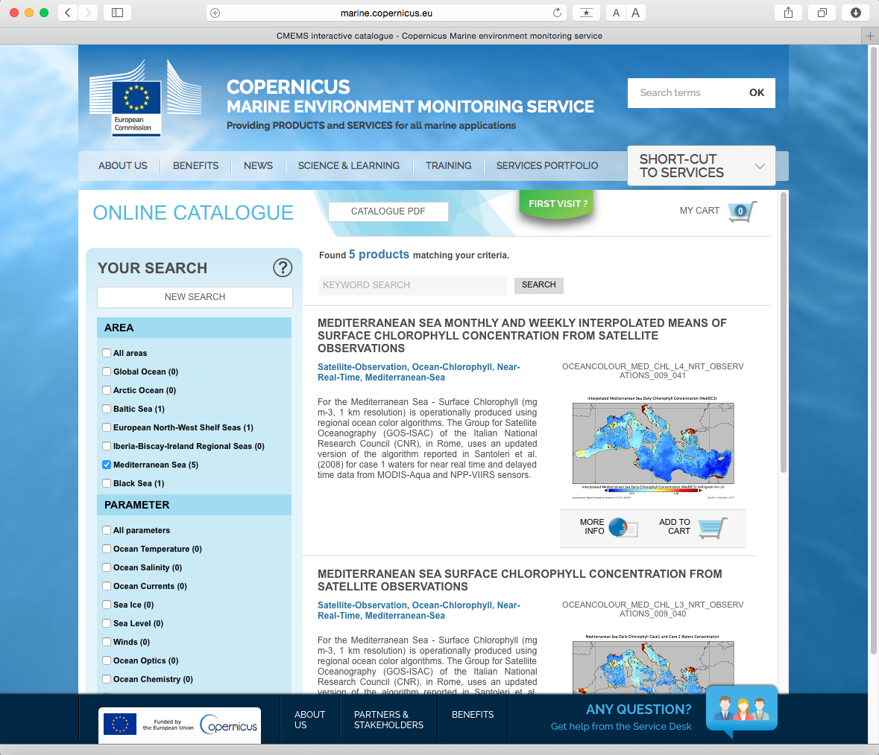
Navigating Med Sea Products in CMEMS Online Catalog

Slide 66
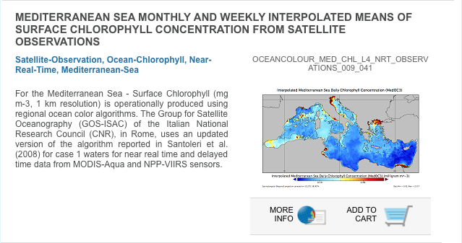
Navigating Med Sea Products in CMEMS Online Catalog

Slide 67
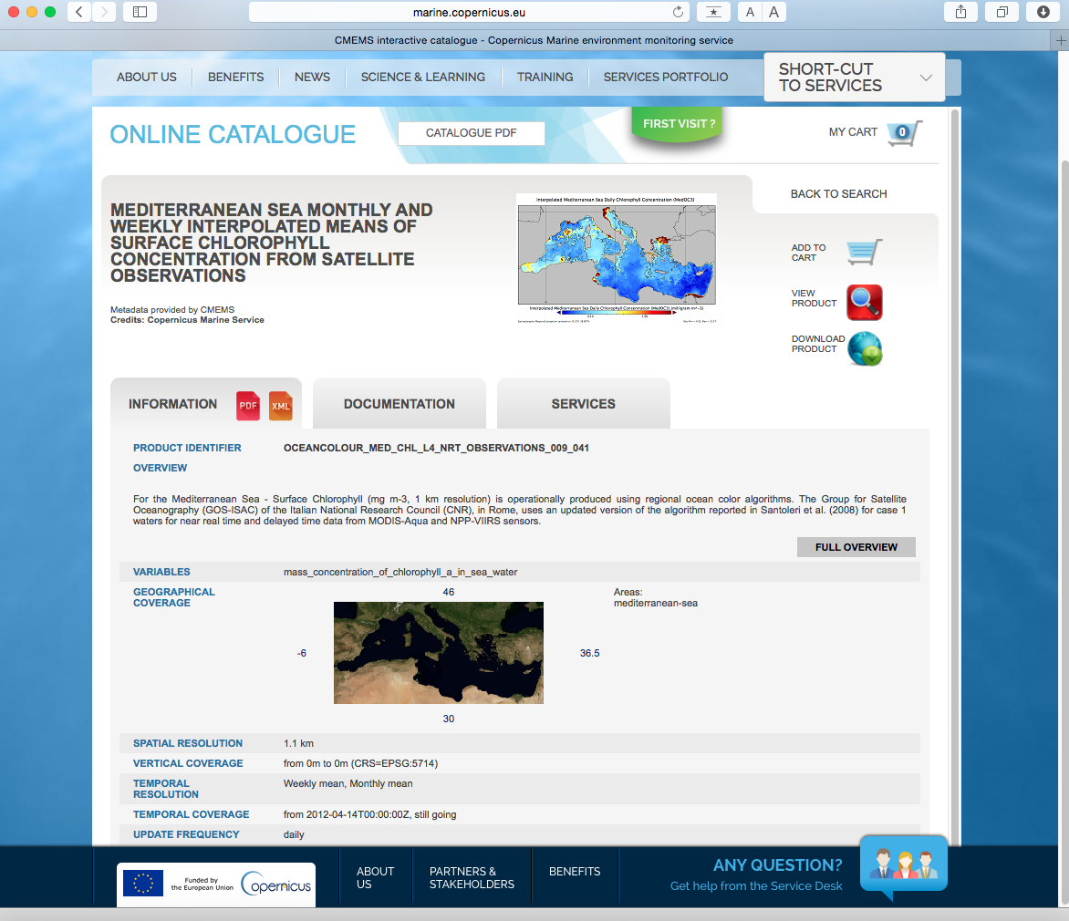
Navigating Med Sea Products in CMEMS Online Catalog

Slide 68
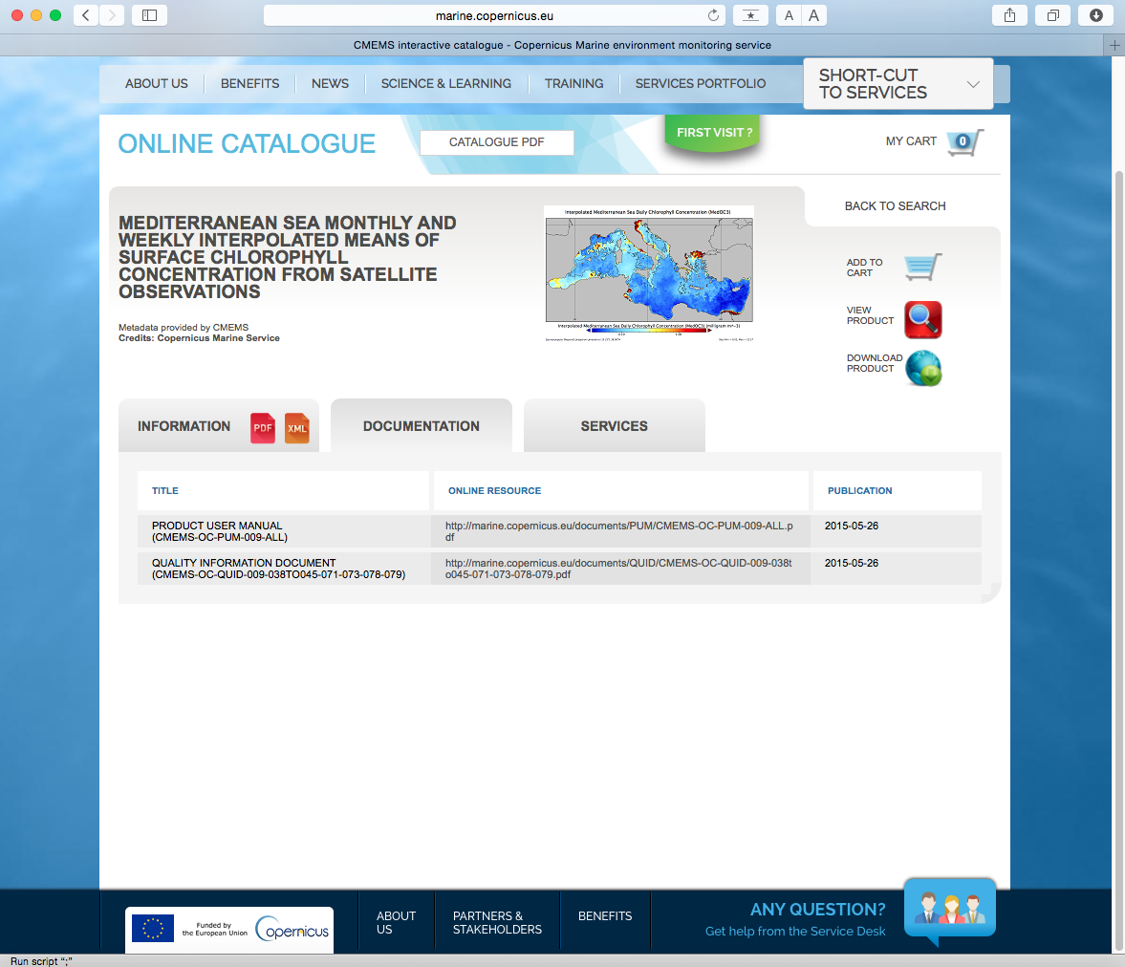
Navigating Med Sea Products in CMEMS Online Catalog

Slide 69
Navigating Med Sea Products in CMEMS Online Catalog

