Slide 1
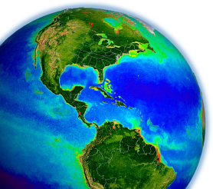
NASA OBPG Update
Multi-Mission Ocean Color Processing
Bryan Franz
and the
Ocean Biology Processing Group
NASA Goddard Space Flight Center
OC-CCI Meeting
23-25 Nov 2015, Plymouth, England

Slide 2
2014.0 Multi-Mission Ocean Color Reprocessing
Scope
CZCS, OCTS, SeaWiFS, MERIS, MODIS(A/T), and VIIRS
Motivation
improve interoperability and sustainability of the product suite by adopting modern data formats, standards, and conventions (netCDF4, CF and ISO conventions, etc.)
incorporate knowledge gained in instrument-specific radiometric calibration and updates to vicarious calibration
incorporate algorithm updates and advances from community and Mission Science Teams developed since 2010 (last algorithm change)
Status
OCTS, VIIRS, MODISA, SeaWiFS done, MODIST & MERIS next

Slide 3
R2014.0 Changes to OC Standard Product Suite
Level-2 OC Product
Algorithm Changes
R_{rs}(λ)
Ångstrom
AOT
Chlorophyll a
K_{d}(490)
POC
PIC
CDOM_index
PAR
nFLH
iPAR
calibration updates, ancillary data updates, improved land/water masking, terrain height, other minor fixes
new algorithm (Hu et al. 2012)
no change
no change
updated algorithm and LUT
remove product (redundant with new IOP suite)
consolidated algorithm, minor fixes
MODIS-only, flagging changes (allow negatives)
MODIS-only, no change
12. IOPs
added suite of inherent optical property products from GIOP (Werdell et al. 2013)

Slide 4
OCI Chlorophyll Algorithm a hybrid approach
CI Line Height Algorithm
better at low chlorophyll
OCx Band Ratio Algorithm
better at mid to high chlorophyll
Chl(CI) ≤ 0.15 mg m⁻³
Chlorophyll = Chl(CI)
0.15 < Chl(CI) < 0.20 mg m⁻³
linear weighting
Chl(CI) ≥ 0.20 mg m⁻³
Chlorophyll = Chl(OCx)
Hu, C., Lee, Z., & Franz, B. (2012). Chlorophyll a algorithms for oligotrophic oceans: A novel approach
based on three-band reflectance difference. Journal of Geophysical Research, 117(C1).

Slide 5
New IOP Product Suite
Products
a(λ) total absorption at all visible wavelengths
bb(λ) total backscatter at all visible wavelengths
aph(λ) absorption due to phytoplankton
adg(443) absorption due to gelb. & detritus at 443nm
Sdg exponential spectral slope for adg
bbp(443) particle backscattering at 443nm
Sbp power-law spectral slope for bbp
uncertainties uncertainties in adg, aph, bbp at 443nm
Rationale
provides sufficient information to compute full spectral component absorption and scattering coefficients and uncertainties
SeaWiFS λ = 412, 443, 490, 510, 555, 670
MODIS λ = 412, 443, 469, 488, 531, 547, 555, 645, 667, 678
VIIRS λ = 410, 443, 486, 551, 671

Slide 6
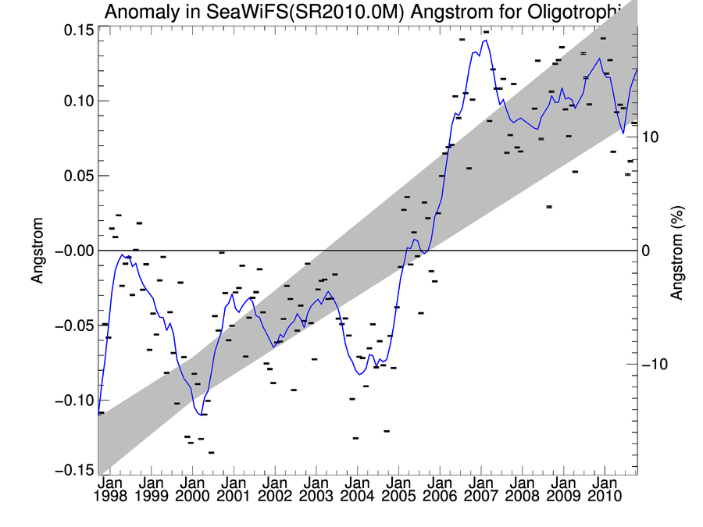
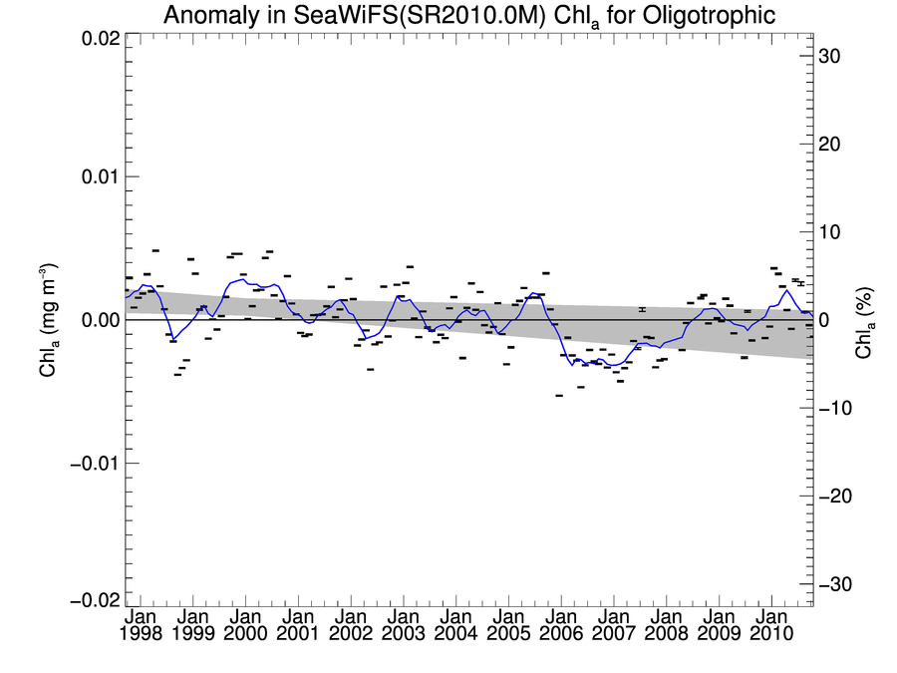
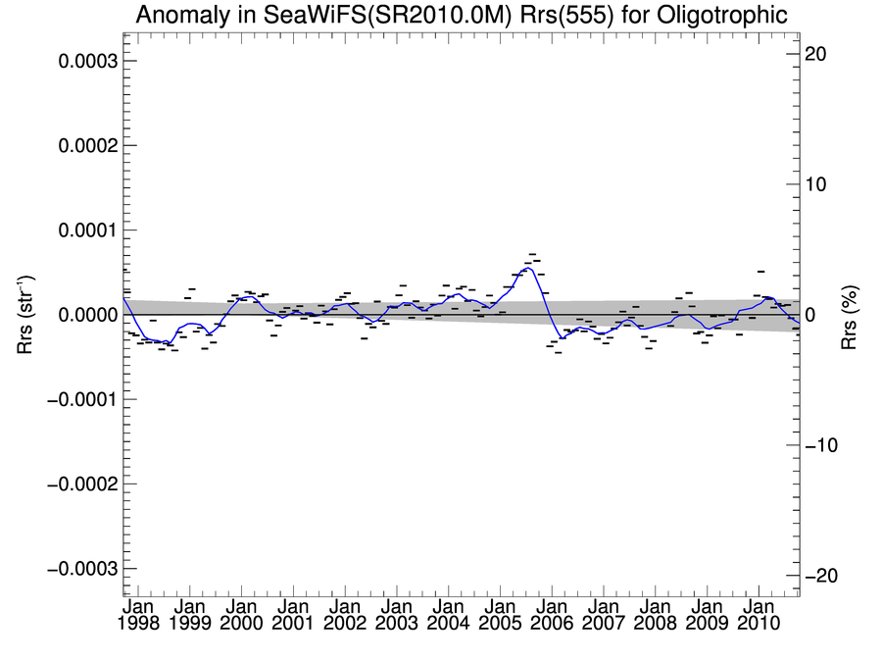
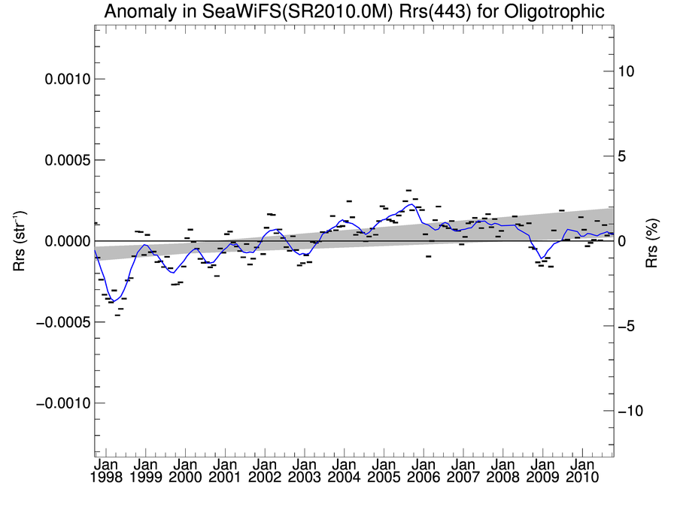
SeaWiFS R2010.0 Radiometric Instability Issue
determined to be due to 1-count shift in avg dark offset
Angstrom
Chlorophyll
global mean clear-water anomaly trends
Rrs(555)
Rrs(443)
+3e-4
+3e-4
-3e-4
-3e-4
Time
Time

Slide 7
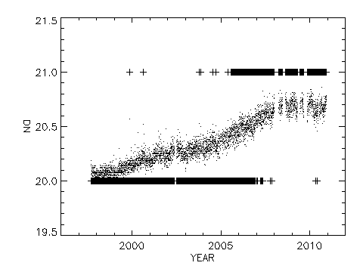
SeaWiFS Calibration Changes
enhanced tracking of dark offset changes (now tracking at the sub-count level, using per detector measurements from intergain cal).
correction for time-dependent change in system spectral response due to spectral dependence of long-term responsivity change (>20% in NIR, 3% in blue). Largest impact at 865nm (0.6% life of mission).
updated correction for differences in degradation of the lunar and earth-view commanded gain for the 765nm channel.
865nm Dark Offsets
median
Offset (Counts)
median

Slide 8
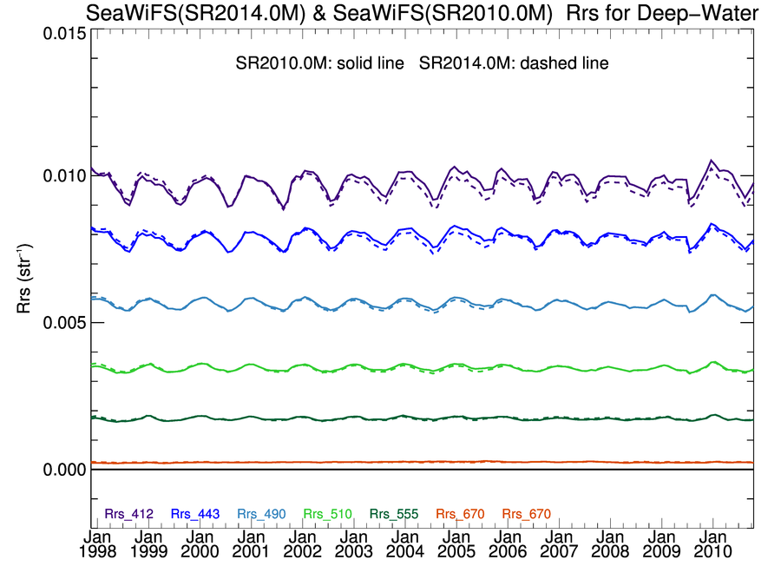

Slide 9
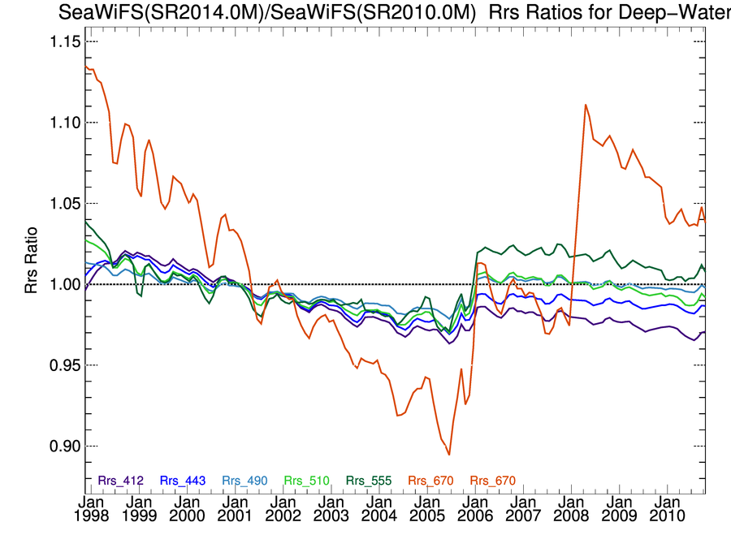

Slide 10
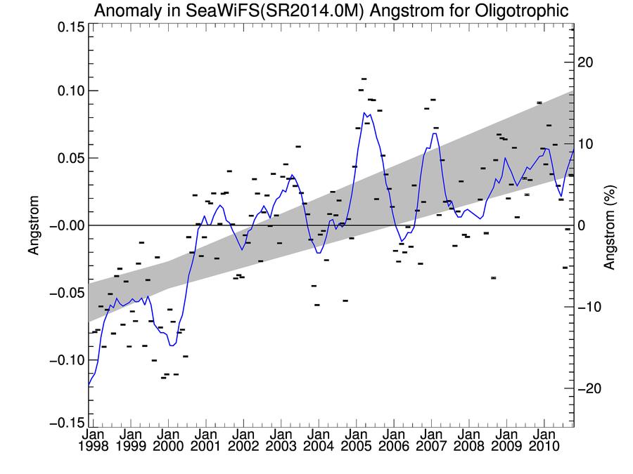
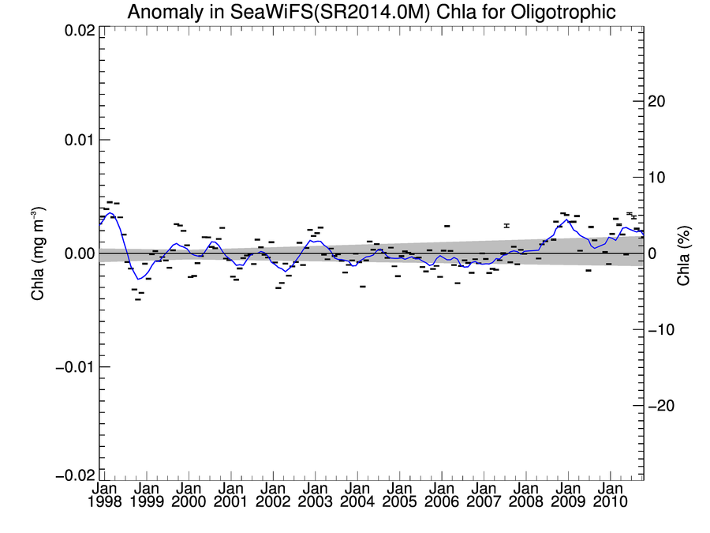
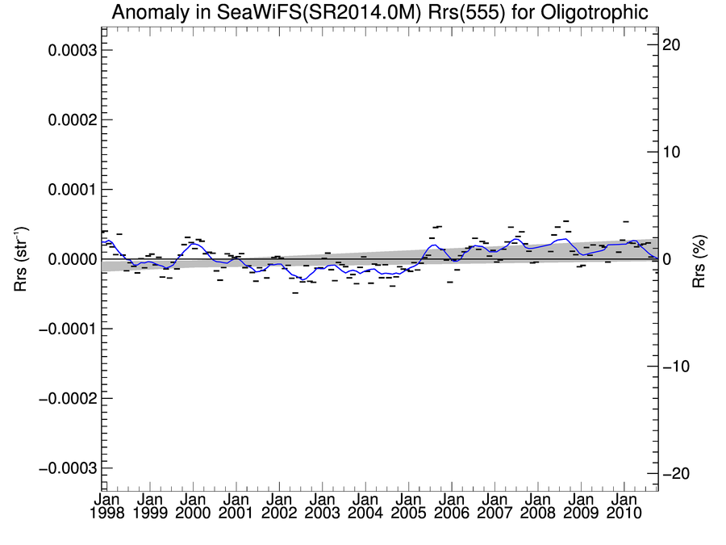
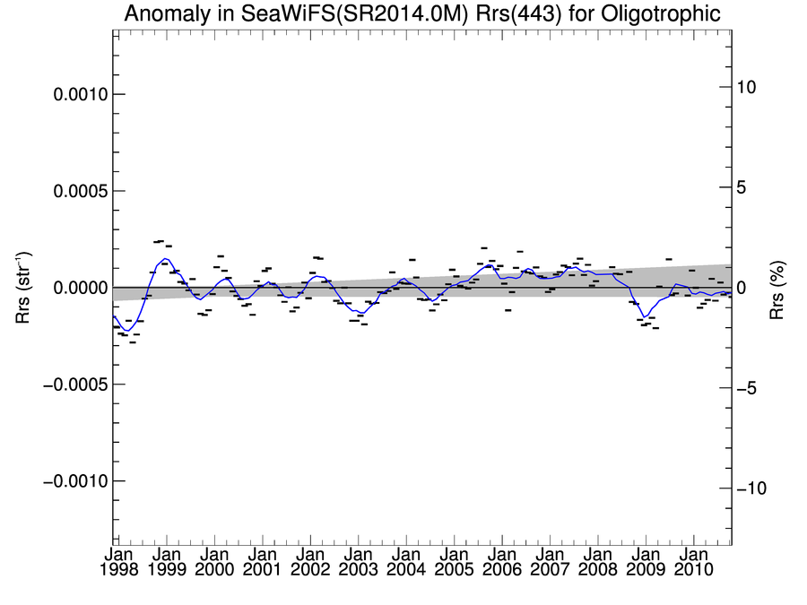
SeaWiFS R2014.0 Proposed Recalibration sub-count dark-offset changes determined from intergain cal
Angstrom
Chlorophyll
global mean clear-water anomaly trends
Rrs(555)
Rrs(443)
+3e-4
+3e-4
-3e-4
-3e-4
Time
Time
Notes:
changes on the order of 10^-4, 10^-5 in 555 in Rrs

Slide 11
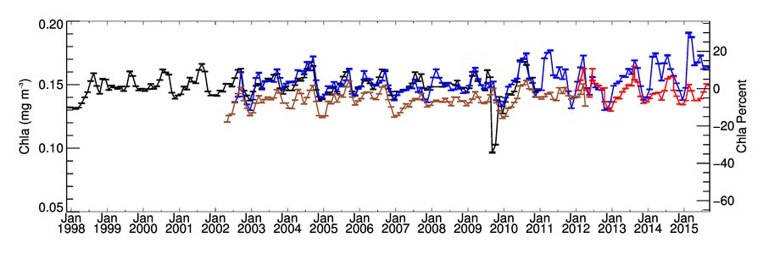
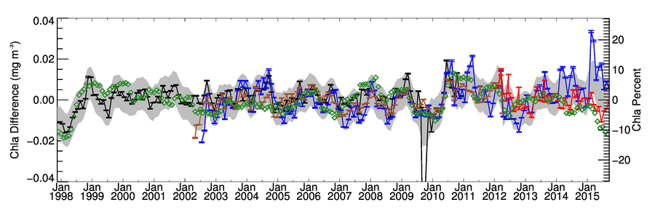
Global Mid-Latitude (+/- 40°) Chlorophyll Time-Series
SeaWiFS
MERIS
MODISA
NASA VIIRS
Anomaly Relative to Mean Seasonal Cycle
Multivariate Enso Index (MEI)
SeaWiFS
MERIS
MODISA
NASA VIIRS
Notes:
VIIRS is now consistent with historical norms

Slide 12
VIIRS Level-1 Redevelopment
NASA is in the process of redeveloping the VIIRS Level-0 to Level-1 and GEO process (multi-disciplinary working group formed).
Motivations are to:
  switch data source from NOAA IDPS to NASA EDOS (like MODIS)
  increase granule size (from 86-sec) and reduce number of files
  provide a more flexible and efficient file format
  include a Level-1A product for distribution of uncalibrated radiances
A new netCDF4 format has been developed for Level-1A, Level-1B, and GEO, following CF and ISO conventions. A 6-minute granule size has been adopted. One file per resolution, rather than one per band.
Software and data feed are in testing now, expected operational by end of year.
This will likely motivate the next VIIRS reprocessing.

Slide 13
Summary
R2014.0 multi-mission ocean color reprocessing underway, VIIRS, MODISA, SeaWIFS complete, MERIS & MODIST in progress.
Significant changes were made to the SeaWiFS calibration, which eliminated some suspect artifacts in the time-series and resulted in improved agreement with MODIS-Aqua over the common mission.
SeaWiFS, MODIS-Aqua, and VIIRS Rrs and derived Chlorophyll are comparable in magnitude and spatial distribution, show a similar level of agreement with in situ validation, and show good temporal consistency.
It is expected that reprocessing of MERIS, to include updated vicarious calibration and new chlorophyll algorithm will resolve bias with other sensors in the R2014.0 data record.

Slide 14
Questions?

